Slide 1
18ECO107T-Fiber Optics and Optoelectronics
L T P C:3 0 0 3
Prepared by
Mrs.G.Annapoorani
A.P(Sr.G), Dept of ECE

Slide 2
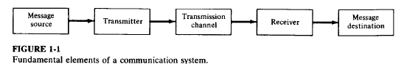
Evolution of communication system
Principal interests of human beings has been to devise communication systems for sending messages from one distant place to another.The fundamental elements of any such communication system is shown Fig 1-1
Information source-inputs message to transmitter
Transmitter –couples message to transmission channel(Channel- medium bridging distance between transmitter and receiver.Types: 1)guided:wire/waveguide
2)Unguided:atmospheric/space channel.
Signal while traversing through channel, it may be attenuated and distorted with distance
Receiver- Extract weakened and distorted signal from channel,amplify it and restore to original form

Slide 3
FORMS OF COMMUNICATION SYSTEM
Motive:
to improve fidelity,
increase data rate so more information could be send
Increase transmission distance between relay stations.
Evolution:
Before 19th century-use of fire signal by greeks in 8th century B.C for sending alarms,calls for help or announcements of certains events.
150B.c.-optical signals were encoded relation to alphabet,so any message could be sent
Limitations: eye used as receiver,LOS transmission paths required.
Telegraph _Samuel.F.B.Morse in 1838 (1844-commercial telegraph implemented)
Used wire cables for information transmission-High frequency carriers used –bandwidth increased so as information capacity.
Applications:Televeision,Radar,Microwavelink
Transmission media used :millimeter and microwave waveguide,metallic wires
Another part of EM spectrum is optical range 50nm(ultraviolet)to about 100Micrometer(far infrared),visible spectrum (400nm to 700nm)band.

Slide 4
Evolution of Fiber optic system
Advent of laser (coherent source)in 1960 paved way for this system.
Optical frequency is 5x10^14Hz, information capacity is 10^5 times greater than microwave system(~10 million TV channels)
Unguided limitations: atmospheric channel by rain,fog,snow and dust make high-speed carrier system economically unattractive in view of present demand of channel capaciy.
It covers only short-distance(up to 1 km)
Optical fiber-more reliable and versatile optical channel than atmosphere,but extremely large loss(morethan 1000dB/km) made them impractical
Lossses due to impurities in fiber material.In 1970, silica fiber having 20dB/km attenuation was fabricated.Later attenuation reduced to 0.16dB/km at 1550-num
Development of optical fiber system grew from combination of semiconductor technology(gives light sources and photodetectors and optical waveguide technology)

Slide 5
Advantages over conventional copper systems
Low transmission loss and wide bandwidth:
carry more data over long distance
Decreased no. of.wires
Reduced no. of repeaters, this in turn decreases system cost and complexity
Small size and weight:
Low weight ,small(hair-sized)
Advantages in aircraft, satellites and ships
Immunity to interference:
Fibers are dielectric in nature ,so they are immune to EMI(Electromagnetic interference) like inductive pickup from signal-carrying wires and lightning. And EMP(pulse) effects which is useful in military applications.
Electrical isolation: Fibers made of glass(insulator)enable them to be attractive in hazardous environments as it creates no arcing or sparking.
Signal security: opaque jacketing around fiber make optical signal well confined in waveguide.can be used in banking,computer networks and military systems
Abundant raw material: Silica is abundant and inexpensive,

Slide 6
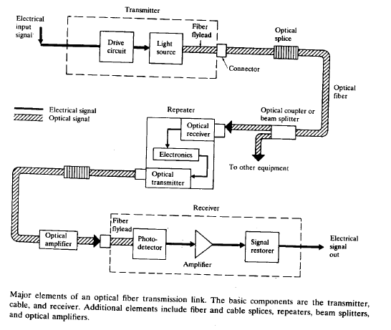
Elements of an optical fiber transmission link(1/4)

Slide 7
Elements of an optical fiber transmission link(2/4)
Key sections:
Transmitter-Consists of light source and its associated drive circuitry
Cable-offering mechanical and environmental protection to optical fibers inside
Receiver-consists of photodetector plus amplification and signal-restoring circuitry.
Additional components: optical connectors,splices,couplers or beam splitters and repeaters
Optical fiber is one of the most important elements in optical fiber link
Installation can be done either aerial,in ducts,undersea, or buried directly in the ground.
Length: several hundred meters to several km for long-distance pplications

Slide 8
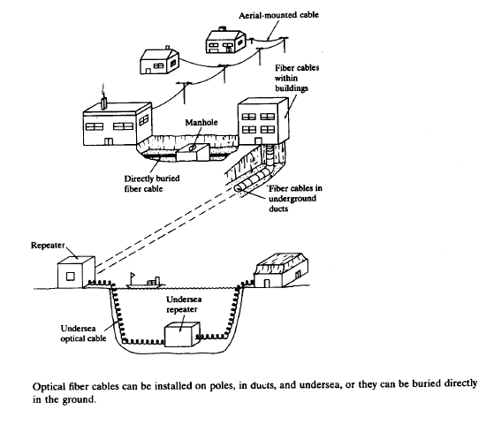

Slide 9
Elements of an optical fiber transmission link(3/4)
Light source : LED / laser-light output modulated rapidly by simply varying bias current.
Electrical input to transmitter can be analog/digital
Optical source is a square –law device, that a linear variation in drive current results in linear change in optical output power
For 800-900 nm light source alloys are GaAIAs.
For 1100 -1600 nm,InGaAsP
Photodiode: progressively attenuated and distorted signal because of scattering,absorption, and dispersion mechanisms in the wavegudie will be detectec.

Slide 10
Elements of an optical fiber transmission link(3/4)
Analagous to light soruce, detectors is also a square-law device (convert received optical power to electric current output).
Types:pin and avalanche photodiodes(APDs){for low power signal}.Both has exhibit high efficiency and response speed.
Receiver: more complex than transmitter, since it has to both amplify and reshape the degraded signal received by photodetector.
Figure of merit for a receiver is the minimum optical power necessary at the desired data rate to attain either a given error probability for digital systems or a specifiied SNR for a n analog system.
Repeater –need in transmission line to amplify and reshape the signal.(it consists of receiver and transmitter placed back to back)
Receiver :detect optical signal and converts to electric signal, which is amplified, reshaped, and sent to electric input of transmitter section.
Transmitter section convert electric signal to optical signal and sends it on down the optical fiber waveguide.

Slide 11
optical fiber
An optical fiber (or fibre) is a flexible, transparent fiber made by drawing glass (silica) or plastic to a diameter slightly thicker than that of a human hair.
Optical fibers are used most often as a means to transmit light between the two ends of the fiber and find wide usage in fiber-optic communications, where they permit transmission over longer distances and at higher bandwidths (data transfer rates) than electrical cables.
Fibers are used instead of metal wires because signals travel along them with less loss; in addition, fibers are immune to electromagnetic interference, a problem from which metal wires suffer.
Fibers are also used for illumination and imaging, and are often wrapped in bundles so they may be used to carry light into, or images out of confined spaces, as in the case of a fiberscope.
Specially designed fibers are also used for a variety of other applications, some of them being fiber optic sensors and fiber lasers.

Slide 12
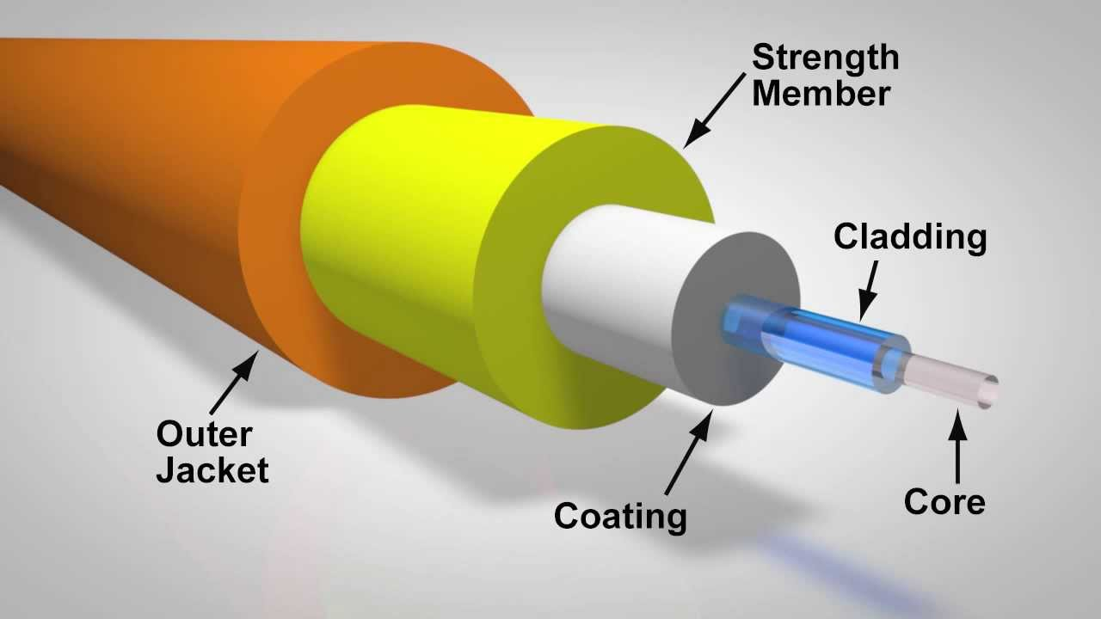
Optical fiber structure

Slide 13
Optical fiber structure
Optical fibers typically include a core surrounded by a transparent cladding material with a lower index of refraction.
Light is kept in the core by the phenomenon of total internal reflection which causes the fiber to act as a waveguide.
Fibers that support many propagation paths or transverse modes are called multi-mode fibers, while those that support a single mode are called single-mode fibers (SMF).
Multi-mode fibers generally have a wider core diameter and are used for short-distance communication links and for applications where high power must be transmitted.

Slide 14
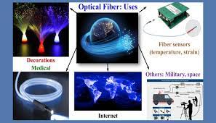
Optical fiber –various applications

Slide 15
Characterisitcs and Behaviour of light
Fiber optics technology involves the emission, transmission, and detection of light let us discuss the nature of light.
Two methods usually used to describe how optical fiber guides light.
Geometrical or ray optics concepts of light: reflection and refraction to provide an intuittive picture of the propagation mechanisms.
Electromagnetic wave approach: where light is treated as an EM wave which propagates along the optical fiber waveguide.(This involves maxwell’s equation subject to cylindrical boundary conditions of fiber.)

Slide 16
The nature of light
Until 17th century, it is believed that light consists of a stream of minute particles that are emitted by luminous sources.
Particles travel in straight line , and assumed to penetrate transparent but reflected from opaque ones.
Described large-scale optical effects like reflection and refraction, but failed to explain interference and diffraction.
Diffraction explanation given by Fresnel in 1815 could be interpreted on assumption that light is a wave motion.
In 1864, Maxwell theorized that light waves must be electromagnetic in nature.
After observation of polarization effects indicated that light waves are transverse(that is, the wave motion is perpendicular to the direction in which the wave travels).
In wave or physical optical view point EM waves radiated by small optical source can be represented by train of spherical wave front(locus of all points in the wave train which have the same phase).
If wavelength of light is smaller than object(or opening ) which it encounters, the wavefront appears as straight lines to this object or opening. In this case, light wave can be represented as a plane wave, and its direction of travel can be indicated by light ray which is perpendicular to the phase front.

Slide 17
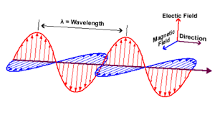

Slide 18
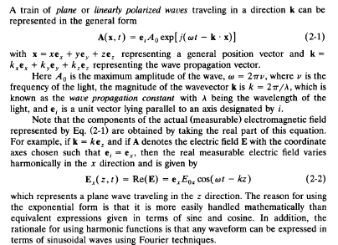
Linear polarization

Slide 19
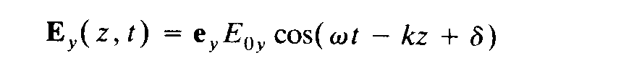
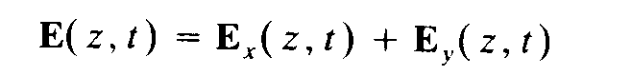
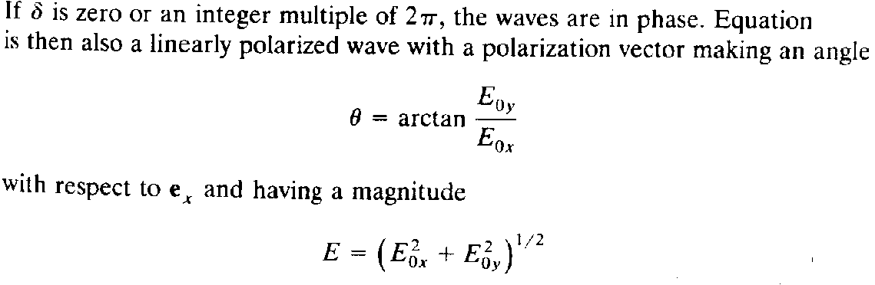
The above equation is for x polarized light, similarly for another orthogonal y polarized light is,

Slide 20
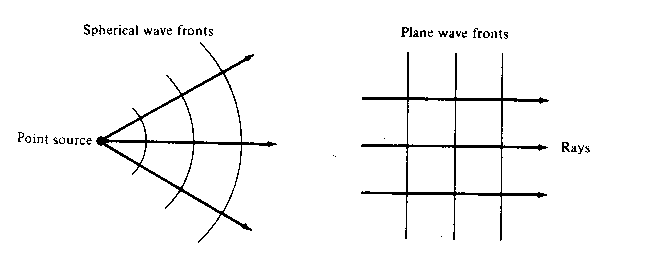
Representations of spherical and plane wavefronts and their associated rays.

Slide 21
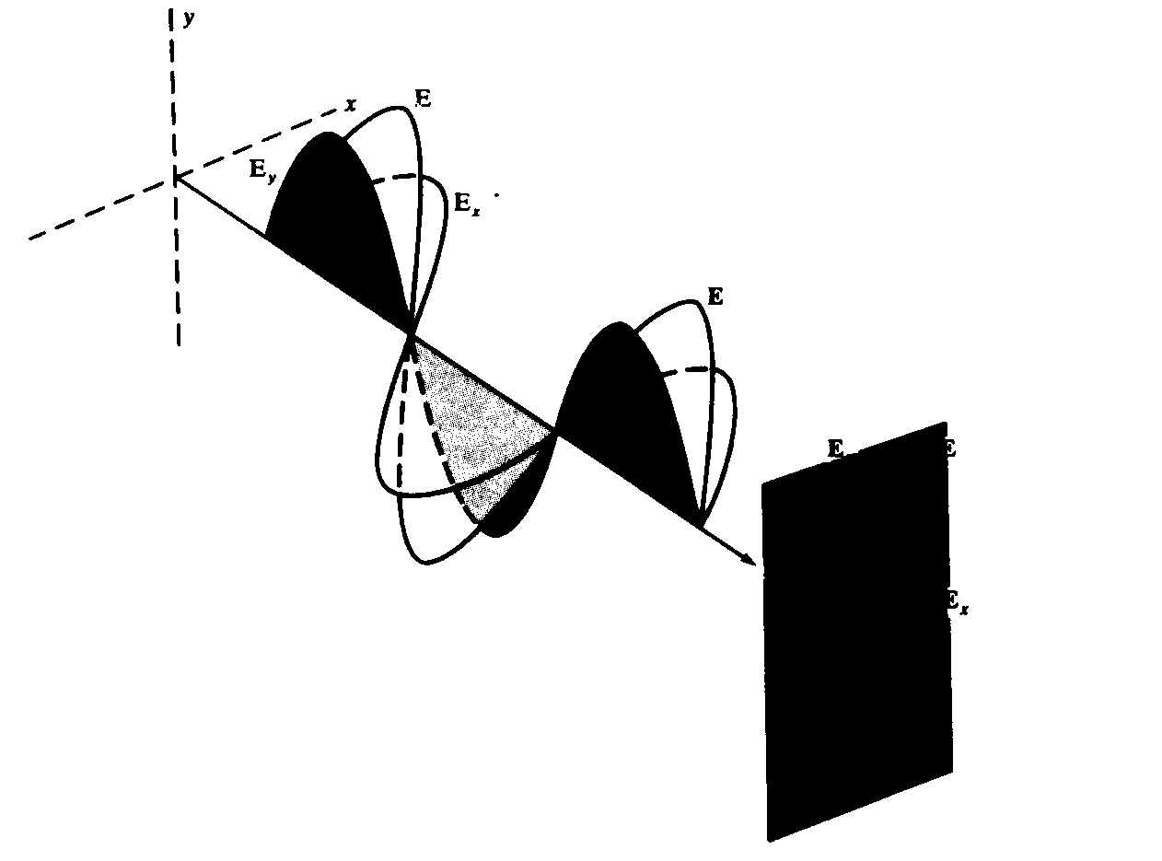
Addition of two linearly polarized waves having zero relative phase between them.

Slide 22
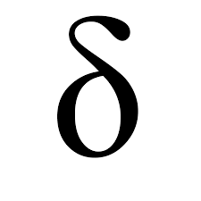
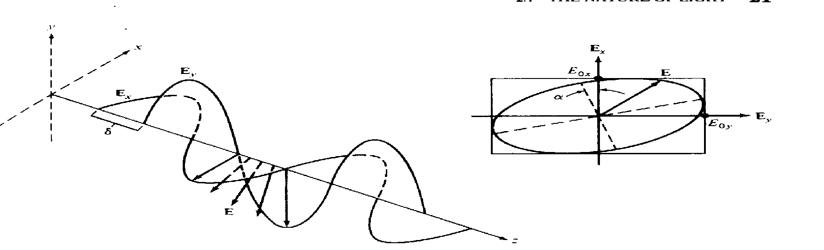
Elliptical and circular polarization
For general values of the wave given by previous equation is elliptically polarized,
For Circular polarization E0x=E0y=E0 and relative phase difference =±π/2+2mπ,where m=0,±1,±2,….whereas for linear polarization its equal to zero.
Resultant field vector E will both rotate and change its magnitude as function of the angular frequency w.

Slide 23
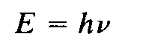
Quantum nature of light
In dealing with interaction of light and matter, such as occurs in dispersion and in the emission and absorption of light, neither the particle theory nor the wave theory of light is appropriate.
Quantum theory – consider particle as well as wave properties.(particle nature arises from observation that light energy is always emitted or absorbed in discrete units called quanta or photons.)
Photon energy depend only on frequency ,which in turn must be measure by observing wave property of light.
Relation between energy E and frequency V of a photon is

Slide 24
Basic optical laws and definitions
Fundamental optical parameter of material is refractive index (or index of refraction).
In free space, light travels at a speed of c=3*10^8m/s.
Speed of light related to frequency v wavelength λ by c=v λ
Upon entering a dielectric or nonconducting medium the wave now travels at a speed v,which is characteristics of material and less than c.
The ratio of the speed of light in a vacuum to that in matter is the index of refraction n of the material and is given by,
n=c/v
Values of n are (1.00 for air, 1.33 for water, 1.50 for glass ,a nd 2.42 for diamond)

Slide 25
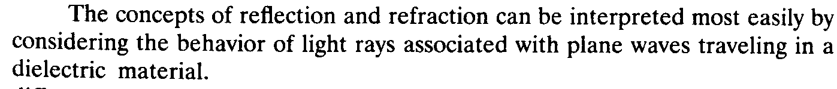
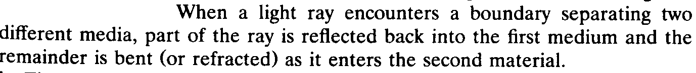
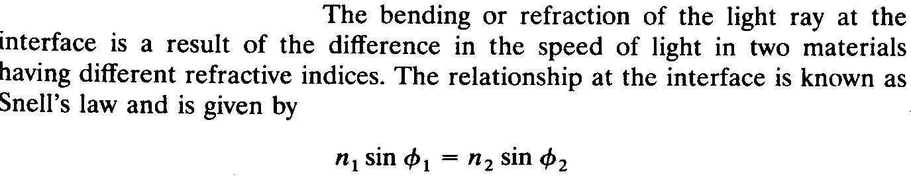
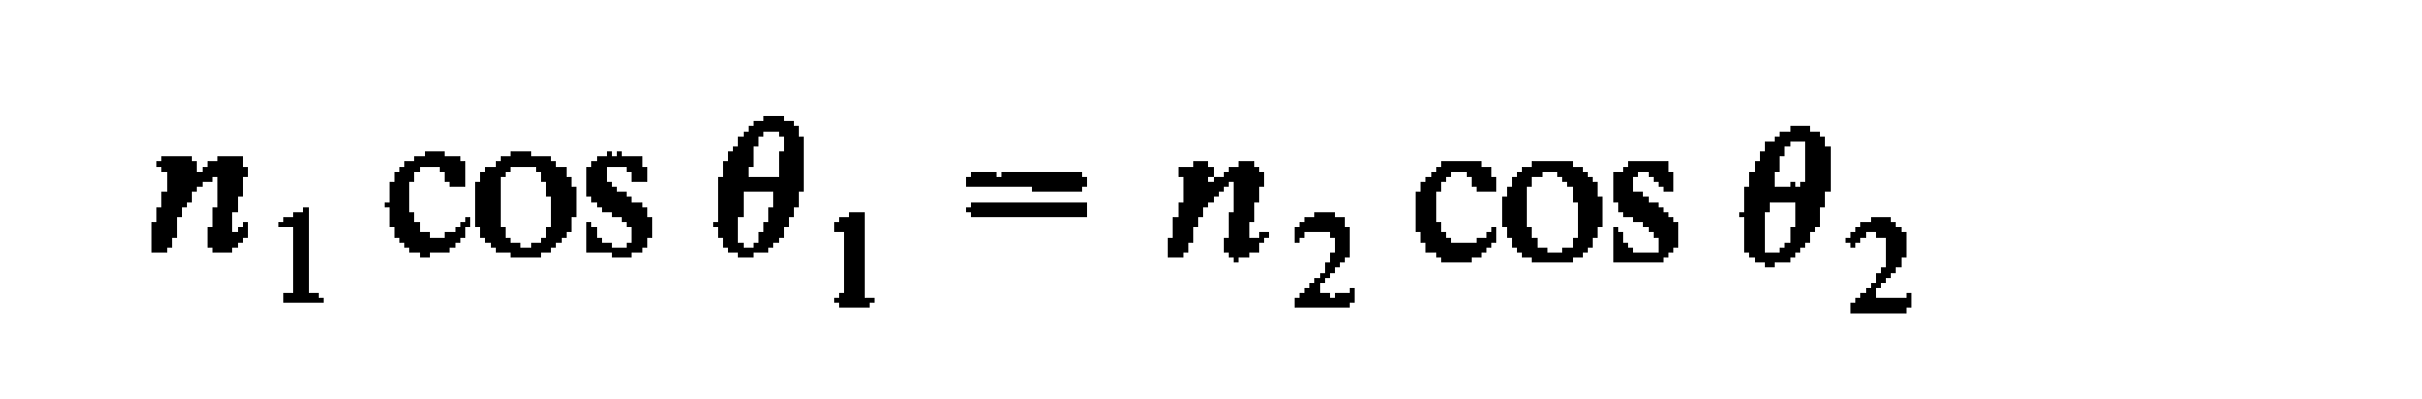

Slide 26
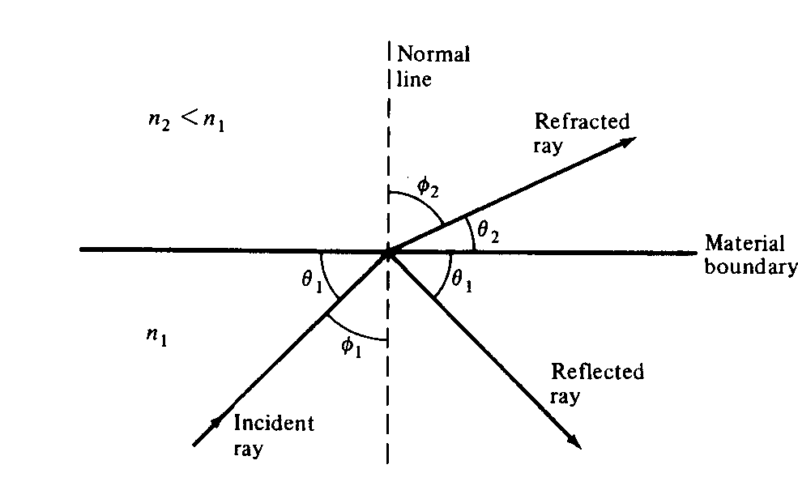
Refraction and reflection of light ray at a material boundary.

Slide 27
According to law of reflection the angle at which incident ray strikes the interface is exactly equal to the angle the reflected ray makes with the same interface.
Incident ray, normal to the interface, reflected ray all lie in the same plane, which is perpendicular to the interface plane between two materials.
When light traveling in certain medium is reflected off an optically denser material (one with high refractive index), its called external reflection.
Conversely, reflection of light off of less optically dense material (such as light traveling in glass being reflected at a glass-to-air interface) is called internal reflection.

Slide 28
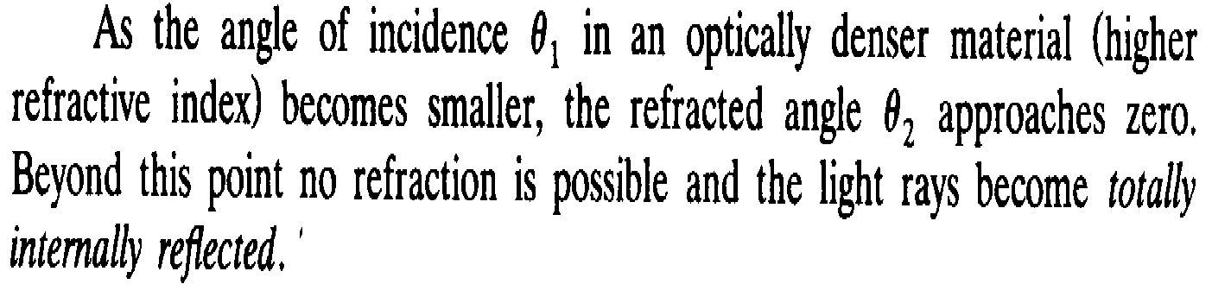
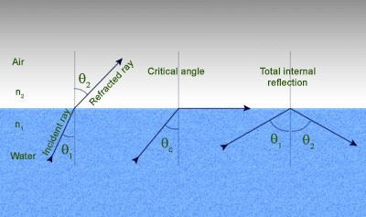
Condition required for total internal reflection can be determined by using snell’s law.

Slide 29
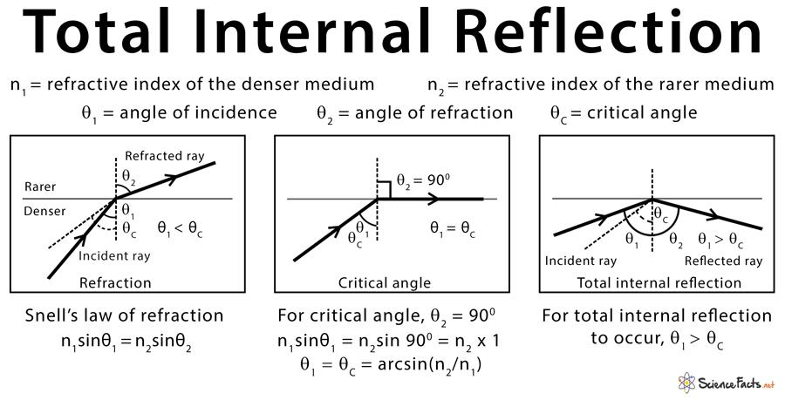

Slide 30
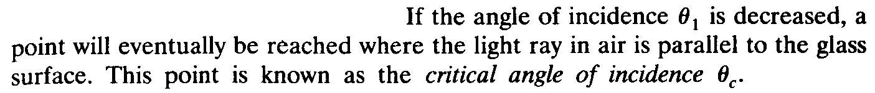
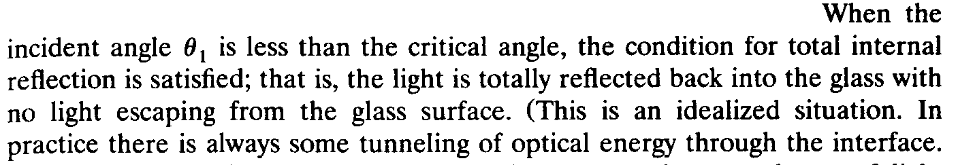
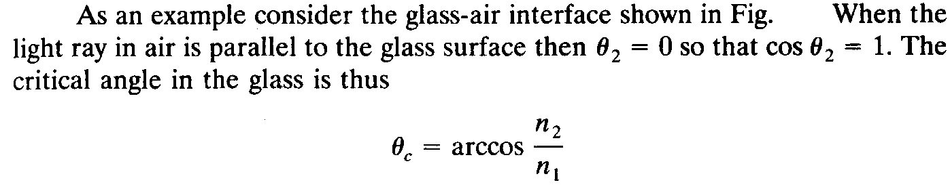

Slide 31

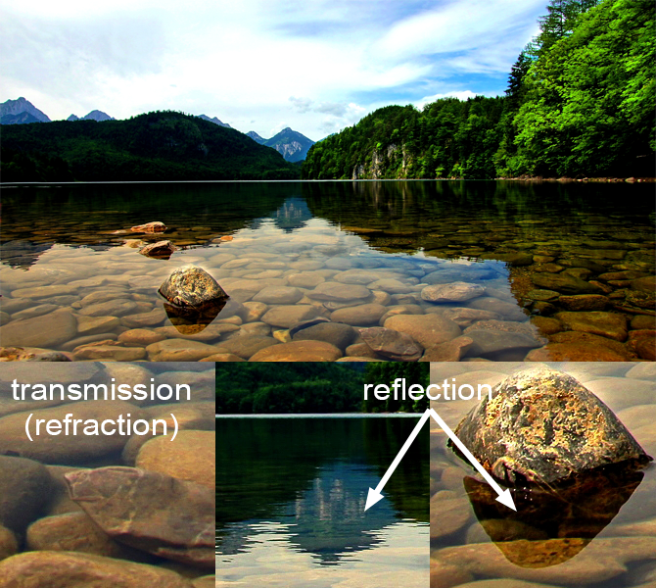
Total internal reflection examples

Slide 32
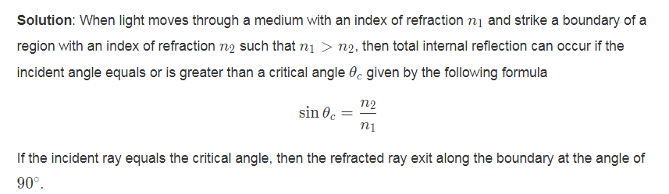
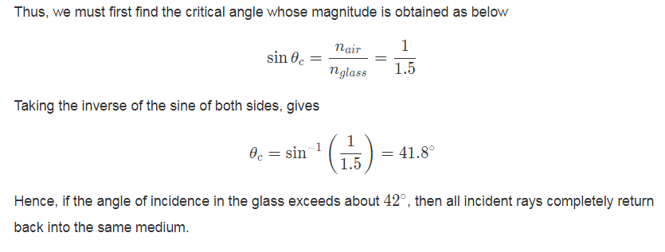
Total Internal Reflection Problems
Problem (1): An unknown glass has an index of refraction of n=1.5 . For a beam of light originated in the glass, at what angles the light 100% reflected back into the glass. (The index of refraction of air is nair=1.00).

Slide 33
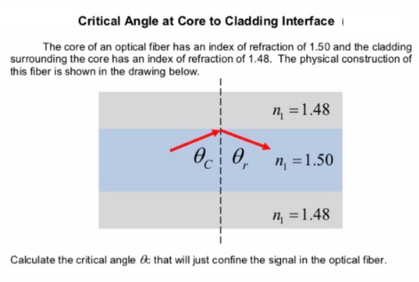
Total Internal Reflection Problems

Slide 34
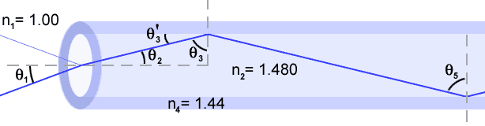
Total Internal Reflection Problems
Consider the optical fiber from Fig . The index of refraction of the inner core is 1.480 , and the index of refraction of the outer cladding is 1.44.
A.What is the critical angle for the core-cladding interface?
B.For what range of angles in the core at the entrance of the fiber (q₂) will the light be completely internally reflected at the core-cladding interface?
C.What range of incidence angles in air does this correspond to?
D.If light is totally internally reflected at the upper edge of the fiber, will it necessarily be totally internally reflected at the lower edge of the fiber (assuming edges are parallel)?

Slide 35
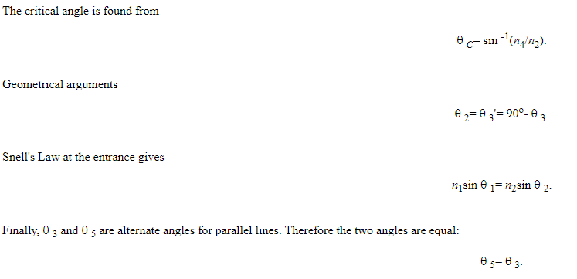

Slide 36
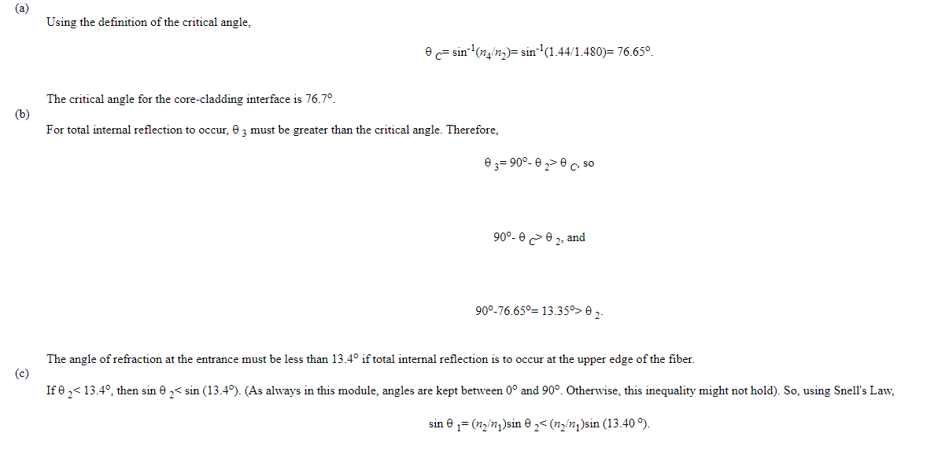

Slide 37
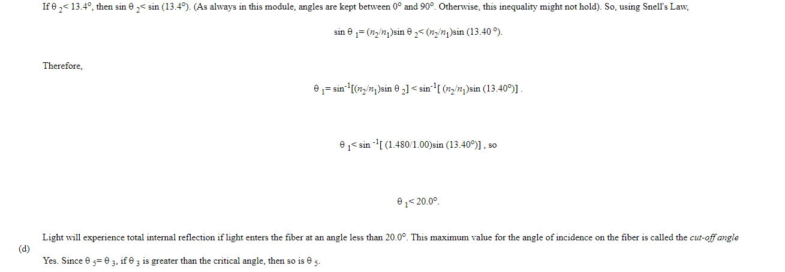

Slide 38
18ECO107T-Fiber Optics and Optoelectronics
(Session 4-6)

Slide 39
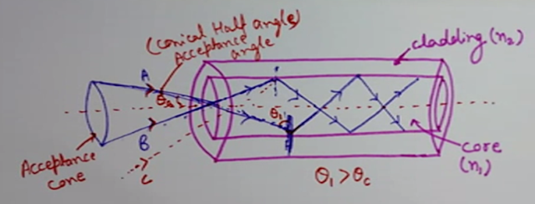
Acceptance Angle
Acceptance angle is the maximum angle with the axis of the Optical Fiber at which the light can enter into the optical fiber in order to be propagated through it

Slide 40
Acceptance Angle Derivation
Let us consider an optical fibre having a core with refractive index n1 and cladding with refractive index n2 such that (n1> n2).
The refractive index of the launching medium is n0.
Let us consider a light ray AO enters the fiber making an angle Theta i with its axis.
OB is the refracted ray that makes an angle Theta r with the axis and strikes core-cladding interface at an angle, which is greater than critical angle.
Thus, it undergoes total internal reflection at the interface

Slide 41
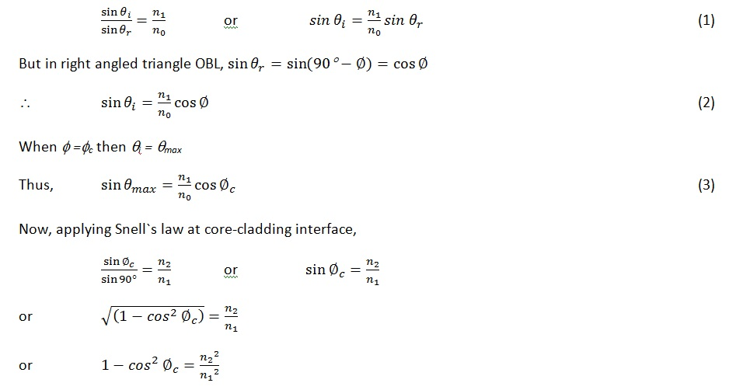

Slide 42
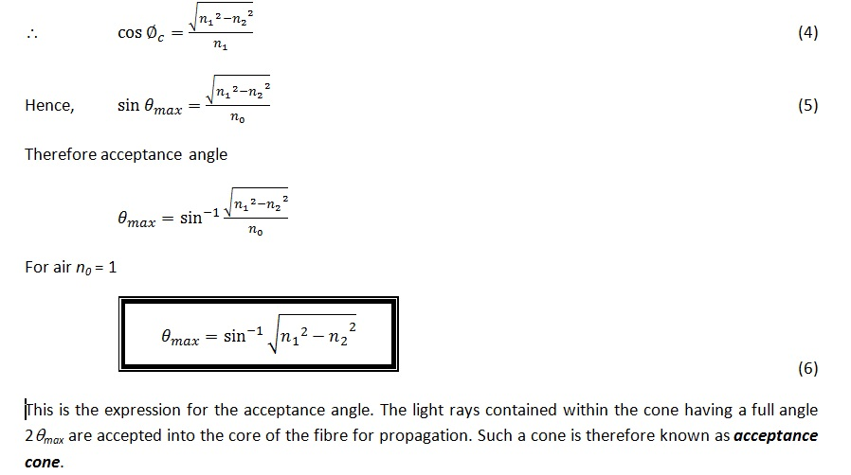

Slide 43
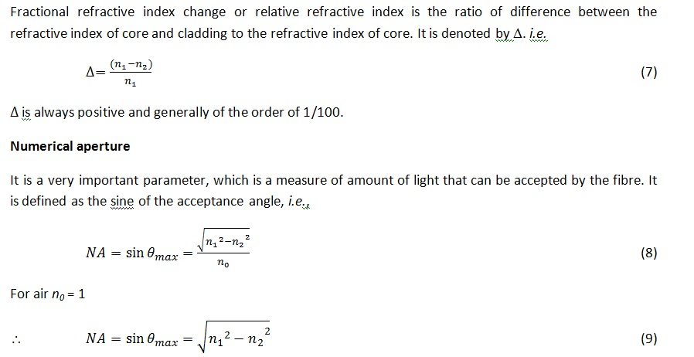

Slide 44
Numerical Aperture
Numerical aperture in case of optical fiber communication can be defined as- "The light gathering (collecting) capacity of an optical fibre".
The numerical aperture provides important relationship between acceptance angle and the refractive index of the core and cladding

Slide 45
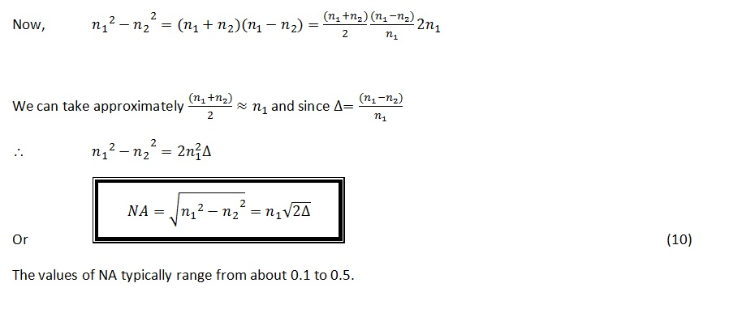

Slide 46
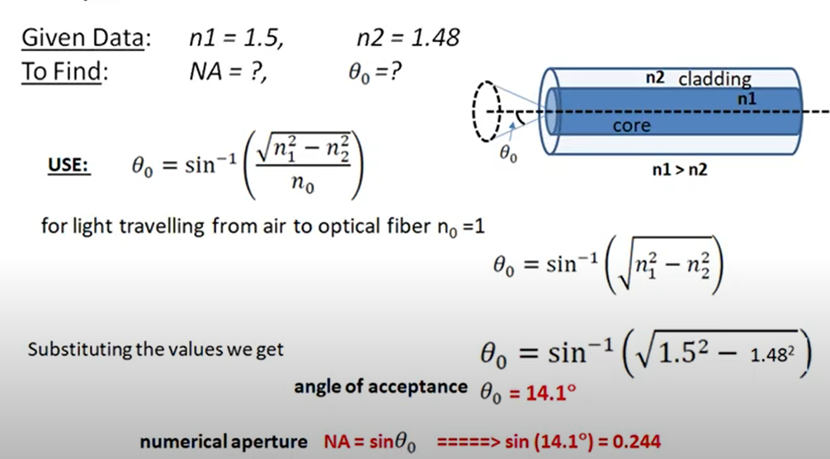
Problem 1:
The Refractive Indices of core and cladding are 1.50 and 1.48 respectively in an Optical Fiber.Find the Numerical Aperture and Acceptance Angle

Slide 47
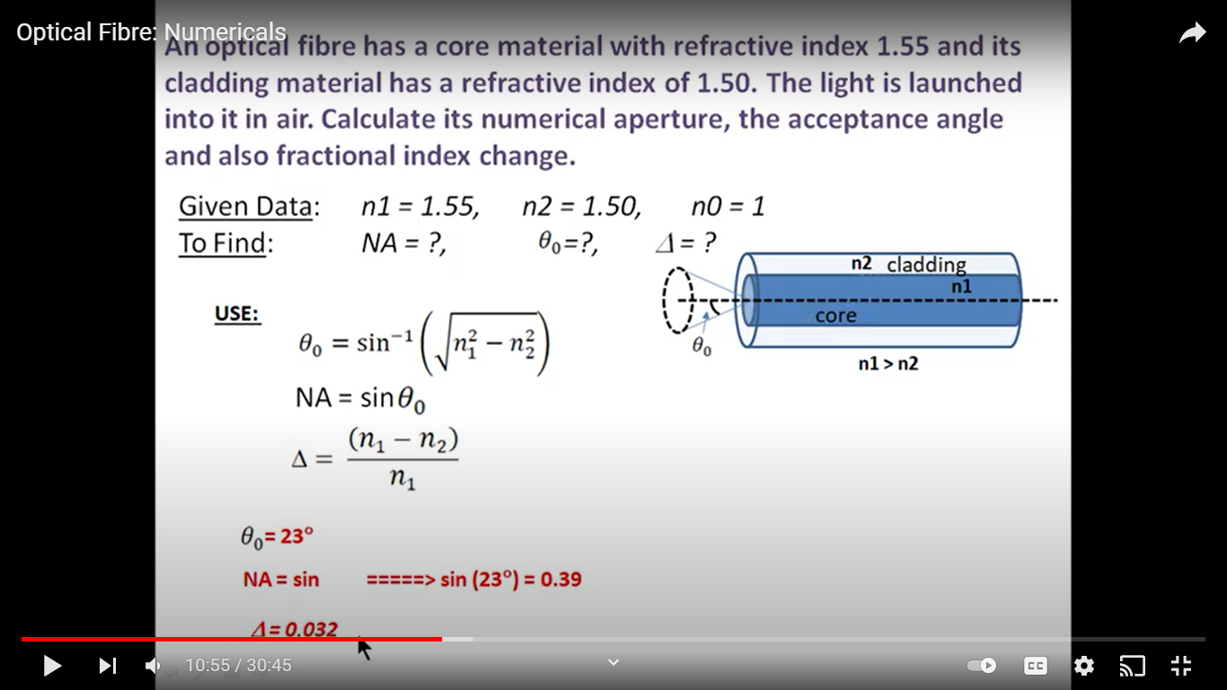
2.An Optical Fiber has a core material with refractive index 1.55 and its cladding material has a refractive index of 1.50.The Light is launched into it in air.Calculate its numerical aperture,the acceptance angle and also fractional index change

Slide 48
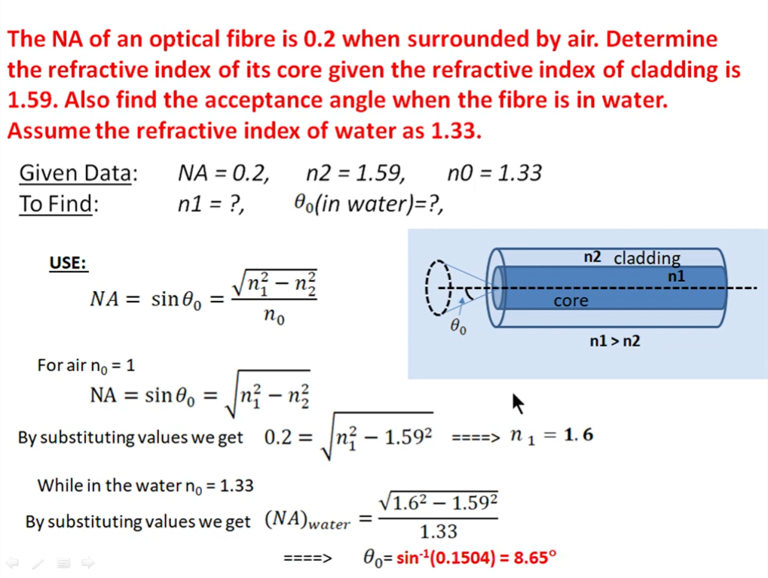

Slide 49
Ray Optics
Optics is the study of light and its interaction with matter.
Light is visible electromagnetic radiation, which transports energy and momentum (linear and angular) from source to detector.
Photonics includes the generation, transmission, modulation,amplification,frequency conversion and detection of light.
Ray optics is the simplest theory of light. Rays travel in optical media according to a set of geometrical rules; hence ray optics is also called geometrical optics.
Ray optics is an approximate theory, but describes accurately a variety of phenomena.
Ray optics is concerned with the locations and directions of light rays, which carry photons and light energy (They also carry momentum, but the direction of the momentum may be different from the ray direction).
It is useful in describing image formation, the guiding of light, and energy transport.

Slide 50
Postulates of Ray Optics
1. Light travels in the form of rays (can think of rays as photon currents).Rays are emitted by light sources, and can be observed by light detectors.
2. An optical medium (through which rays propagate) is characterized by a real scalar quantity n ≥ 1, called the refractive index. The speed of light in vacuum is c = 3 × 108m/s.The speed of light in a medium is v = c/n; this is the definition of the refractive index. The time taken by light to cover a distance d is t = nd/c; it is proportional to nd, which is called the optical path length.

Slide 51
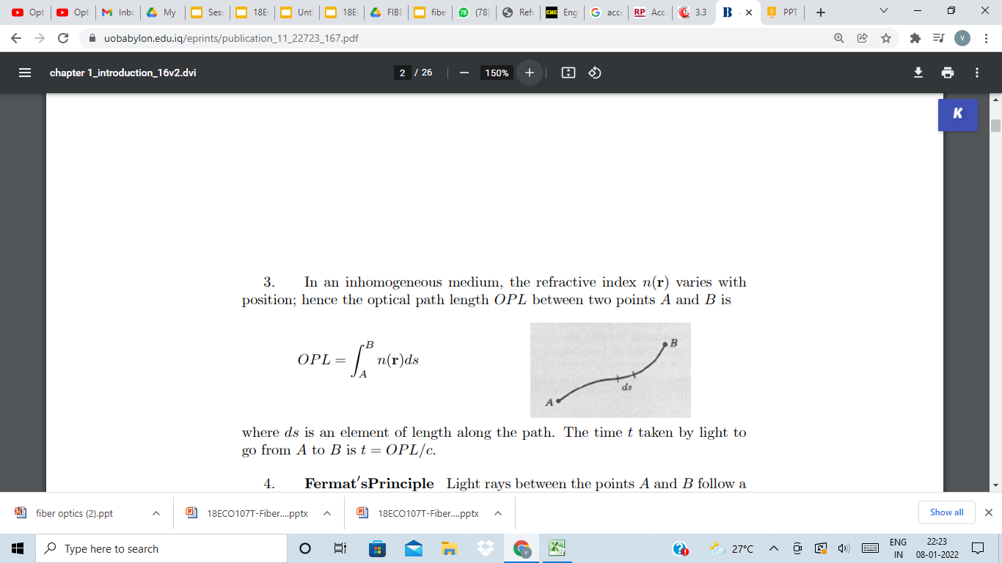
Postulates of Ray Optics
3. In an inhomogeneous medium, the refractive index n(r) varies with
position; hence the optical path length OPL between two points A and B is
where ds is an element of length along the path. The time t taken by light to
go from A to B is t = OPL/c.

Slide 52
Types of Rays
Rays that Interact with surfaces
An incident ray is a ray of light that strikes a surface. The angle between this ray and the perpendicular or normal to the surface is the angle of incidence
The reflected ray corresponding to a given incident ray, is the ray that represents the light reflected by the surface. The angle between the surface normal and the reflected ray is known as the angle of reflection. The Law of Reflection says that for a specular (non-scattering) surface, the angle of reflection is always equal to the angle of incidence.

Slide 53
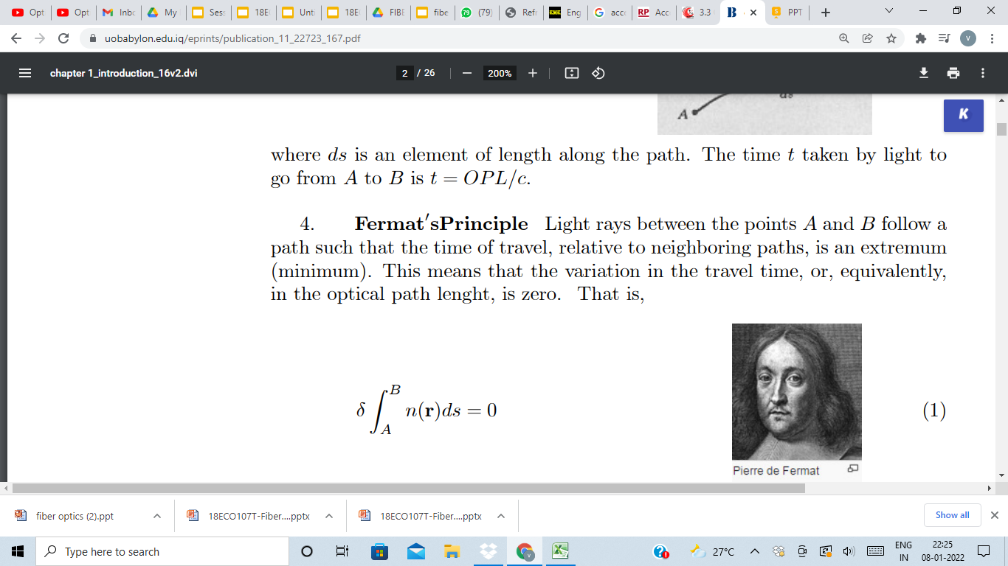
Postulates of Ray Optics
4.Light rays between the points A and B follow a path such that the time of travel, relative to neighboring paths, is an extremum (minimum). This means that the variation in the travel time, or, equivalently,in the optical path lenght, is zero. That is,
Usually, the extremum is a minimum; then light rays travel along the path of least time. If there are many paths with the minimum time, then light rays travel along all of these simultaneously.

Slide 54
Types of rays
The refracted ray or transmitted ray corresponding to a given incident ray represents the light that is transmitted through the surface. The angle between this ray and the normal is known as the angle of refraction, and it is given by Snell's Law. Conservation of energy requires that the power in the incident ray must equal the sum of the power in the refracted ray, the power in the reflected ray, and any power absorbed at the surface
If the material is birefringent, the refracted ray may split into ordinary and extraordinary rays, which experience different indexes of refraction when passing through the birefringent material.

Slide 55
Types of rays
The principal ray or chief ray (sometimes known as the b ray) in an optical system is the meridional ray that starts at the edge of the object, and passes through the center of the aperture stop
Sagittal ray or transverse ray
Paraxial ray
Parabasal ray

Slide 56
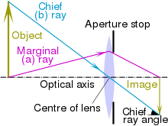
Types of rays
Optical systems
A meridional ray or tangential ray is a ray that is confined to the plane containing the system's optical axis and the object point from which the ray originated.
A skew ray is a ray that does not propagate in a plane that contains both the object point and the optical axis. Such rays do not cross the optical axis anywhere, and are not parallel to it.
The marginal ray (sometimes known as an a ray or a marginal axial ray) in an optical system is the meridional ray that starts at the point where the object crosses the optical axis, and touches the edge of the aperture stop of the system.

Slide 57
UNIT I - S7,S8,S9- Topics
Optical fiber modes, Optical fiber configurations, Single mode fibers, Multimode Fibers, Step Index Fibers, Graded IndEX FIBERS

Slide 58
Optical fiber modes
Optical fiber is classified into 2 categories
1. Number of modes
Single Mode Fiber (SMF)
Multi Mode Fiber (MMF)
Refractive Index
Step Index (Single mode/ Munltimode)
Graded Index

Slide 59
Based on Number of Modes

Slide 60
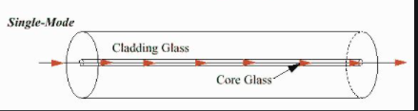
Single mode fiber
Only one mode can propagate through the fiber
Core diameter (5um) and high cladding diameter (70um)
Difference between the R.I of core and cladding is very small.
There is neither dispersion nor degradation therefore it is suitable for long distance communication.
Light is passed through the single mode fiber through laser diode.

Slide 61
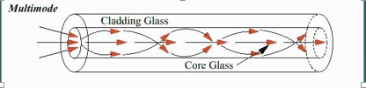
Multimode fiber
Allows large number of modes for light ray travelling through it.
Core diameter is 40un and Cladding is 70um
The relative refractive index is larger than single mode fiber.
Due to multimode dispersion, signal degradation takes place.
Not suitable for long distance communication due to large dispersion and attenuation.

Slide 62
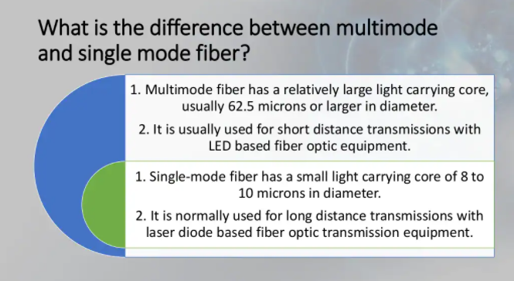

Slide 63
Based on Refractive Index

Slide 64
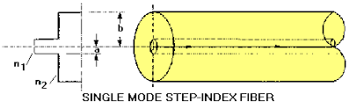
Single mode step index fiber
A single mode or monomode step index fiber allows the propagation of only one traverse electromagnetic mode and hence the core diameter must be of the order of 2 µm to 10µm. It has high information carrying capacity.

Slide 65
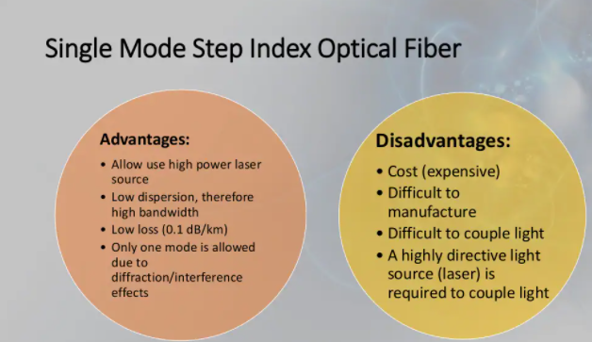

Slide 66

Multi mode Step Index fiber
The Refractive index for core and cladding are constant.
The light ray propagate through it in the form of meridiognal rays which cross the fiber axis during every reflection at the core cladding boundary.

Slide 67


Slide 68

Single mode and multimode step index fiber

Slide 69


Multimode Graded Index fiber
Fiber core has a non-uniform refractive index that gradually decreases from the center towards the core cladding interface.
Cladding has uniform Refractive index,
Light rays propagate through it in the form of helical rays.

Slide 70


Slide 71

Based on the refractive Index

Slide 72


Slide 73

Problem

Slide 74


Slide 75


Slide 76


Slide 77


Slide 78


Slide 79


Slide 80


